Slide 1

Healthcare Revenue Cycle Intelligence Studio
Demo
Prepared By
Desta Ensermu ( Data Analyst, Vibe Coder)

Slide 2
Healthcare Revenue Cycle Intelligence Studio
1. Product Summary
Revenue Cycle Intelligence Studio is a browser-based healthcare revenue cycle analytics platform that combines revenue leakage analysis, denial intelligence, KPI monitoring, executive reporting, and dataset management in one modular application.
The product transforms operational revenue cycle data into clear dashboards, trends, root-cause findings, and exportable reports without sending data to an external server.
The application is designed for healthcare analysts, revenue cycle teams, finance leaders, health informatics professionals, educators, consultants, and portfolio demonstrations.

Slide 3
2. Problem Statement
Healthcare revenue cycle data is often fragmented across spreadsheets, billing extracts, denial reports, accounts receivable files, payment reports, and departmental scorecards.
This fragmentation causes several problems
- Revenue leakage is difficult to quantify
- Denial causes are reviewed manually
- KPI definitions are inconsistent
- Analysts repeat the same spreadsheet work
- Executives lack a unified performance view
- Reports are difficult to reproduce
Data may be shared through tools that are not appropriate for sensitive information.
Existing enterprise platforms may be costly, complex, or dependent on integrations

Slide 4
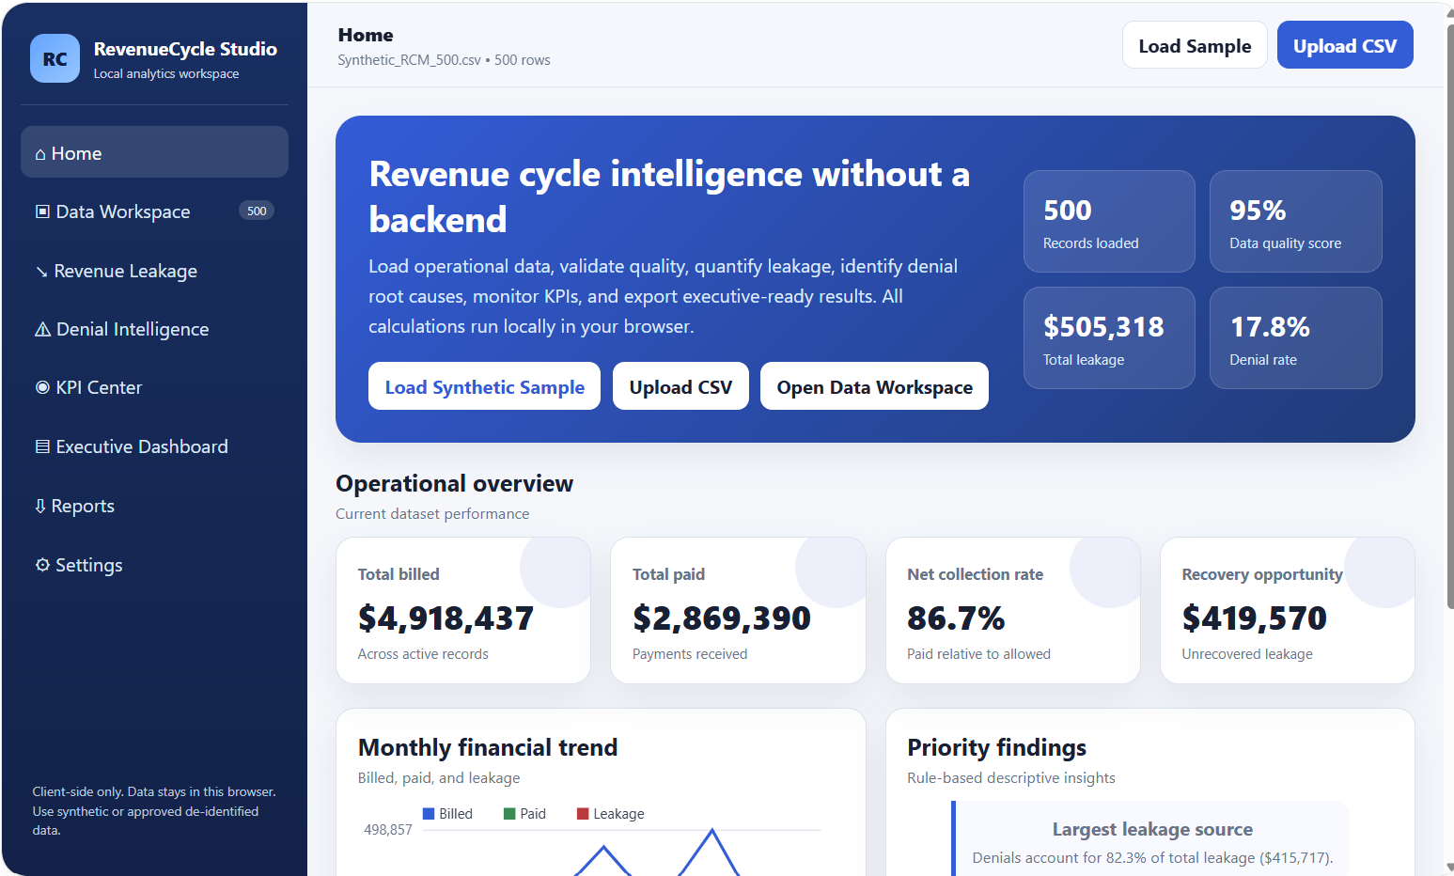
Product Preview

Slide 5
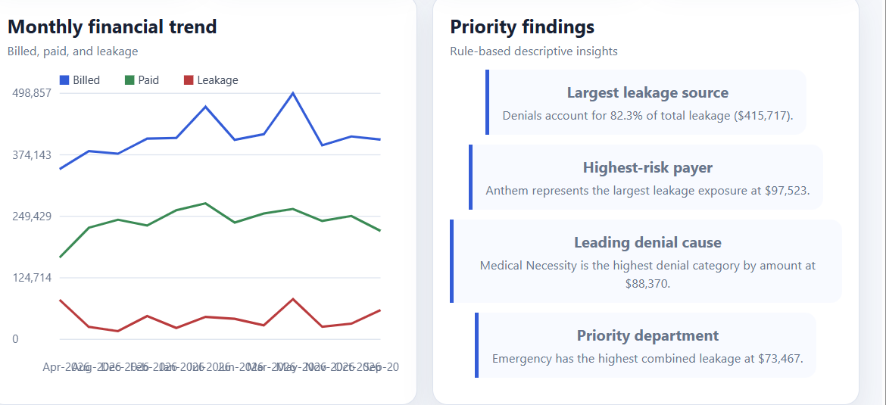
Trends and Findings

Slide 6
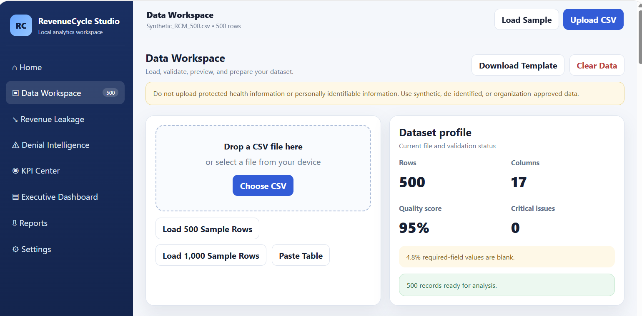
Dataset Profile

Slide 7
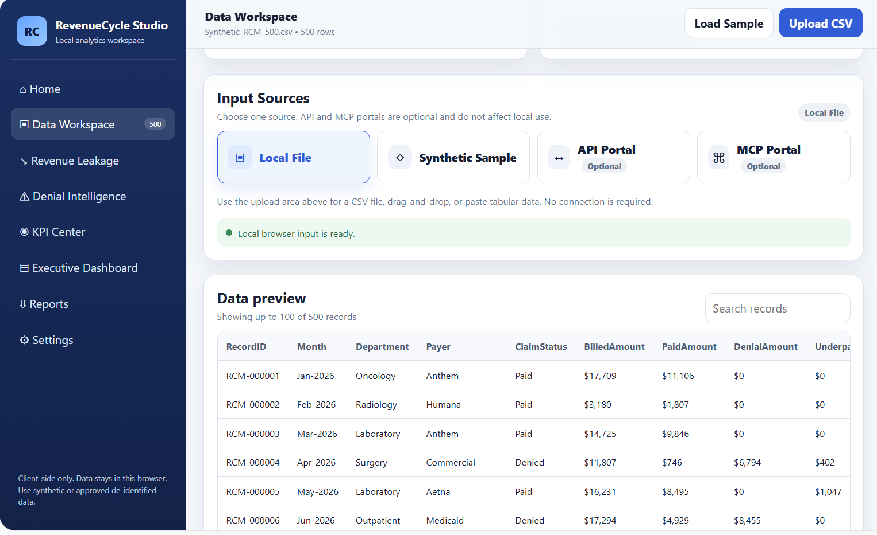
Data Workspace…

Slide 8
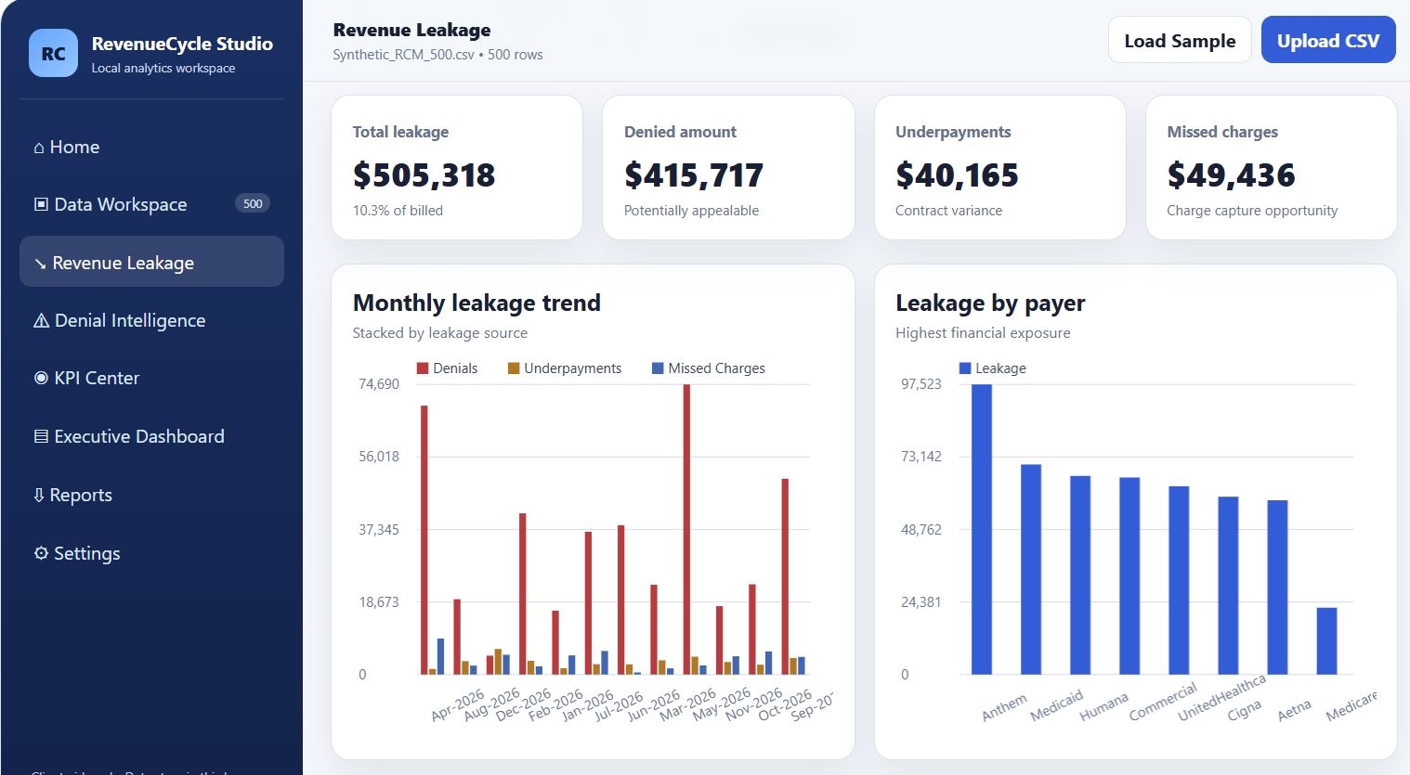
Revenue Leakage

Slide 9
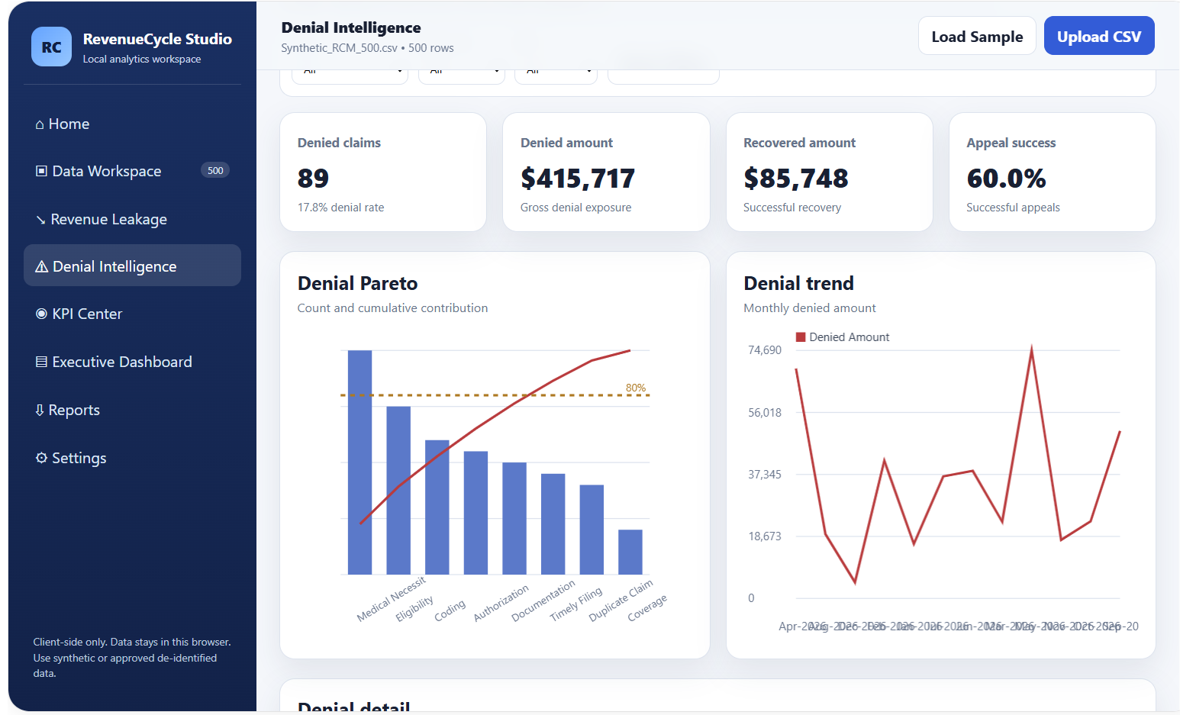
Denial Intelligence

Slide 10
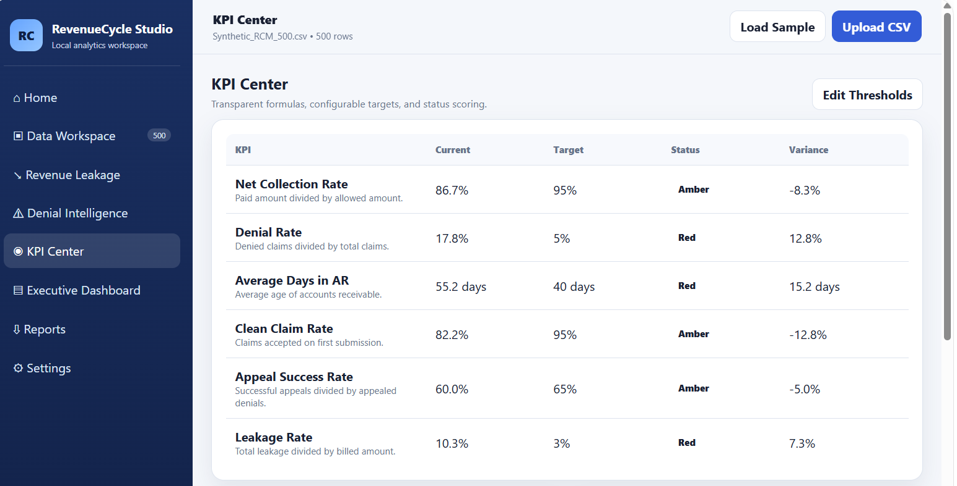
KPI Center

Slide 11
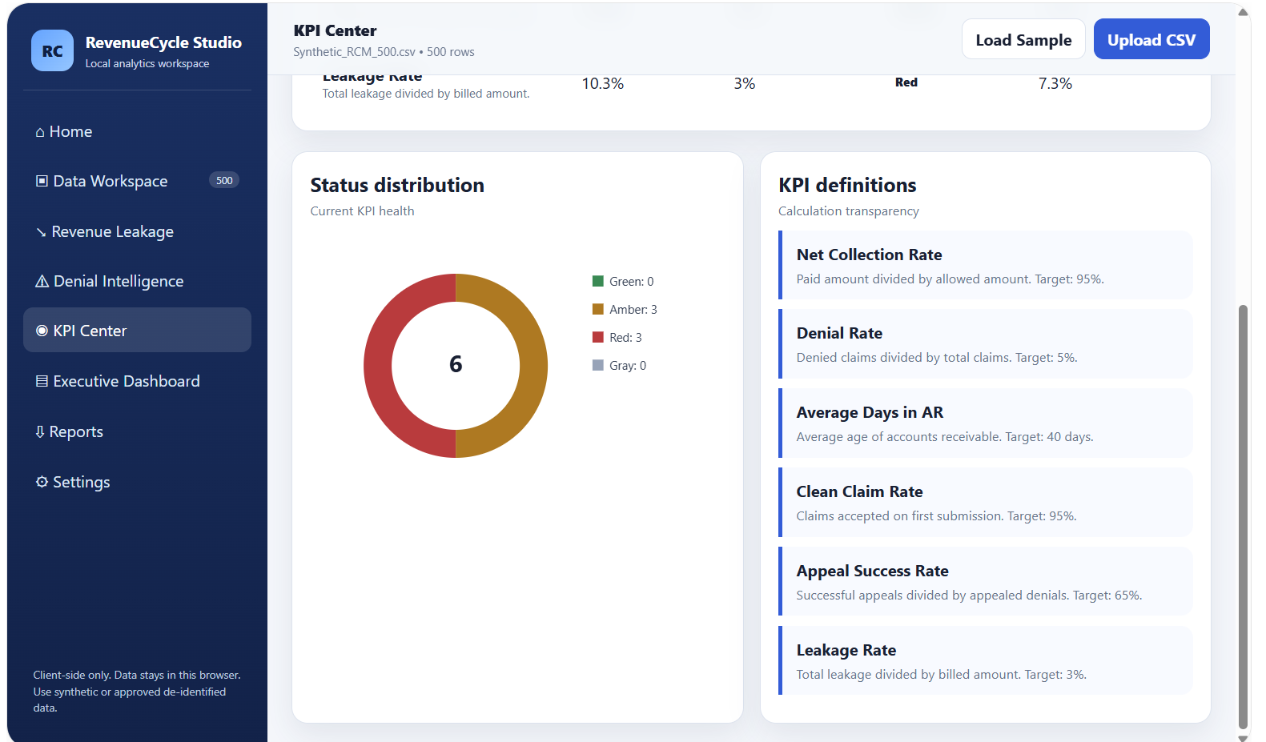
KPI Center- Status Distribution and definition

Slide 12
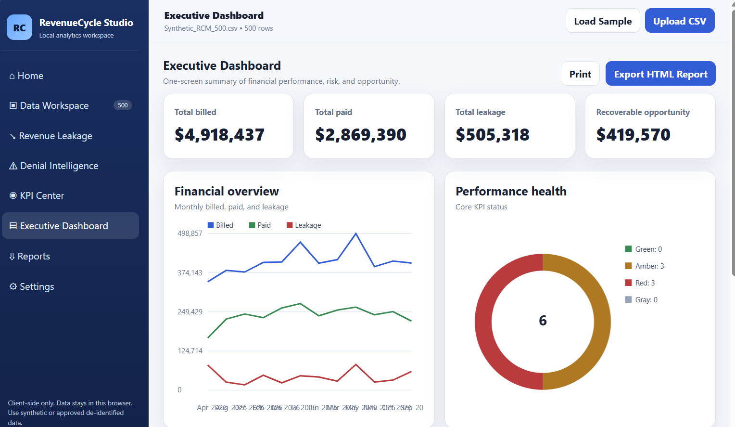
Executive Dashboard

Slide 13
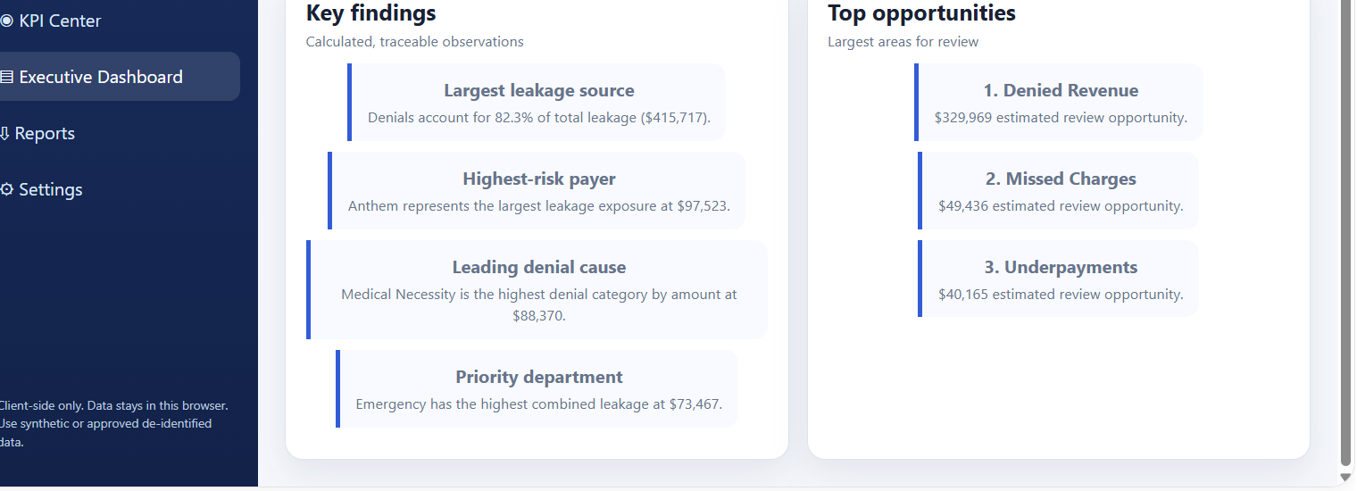
Key Findings and Top Opportunities

Slide 14
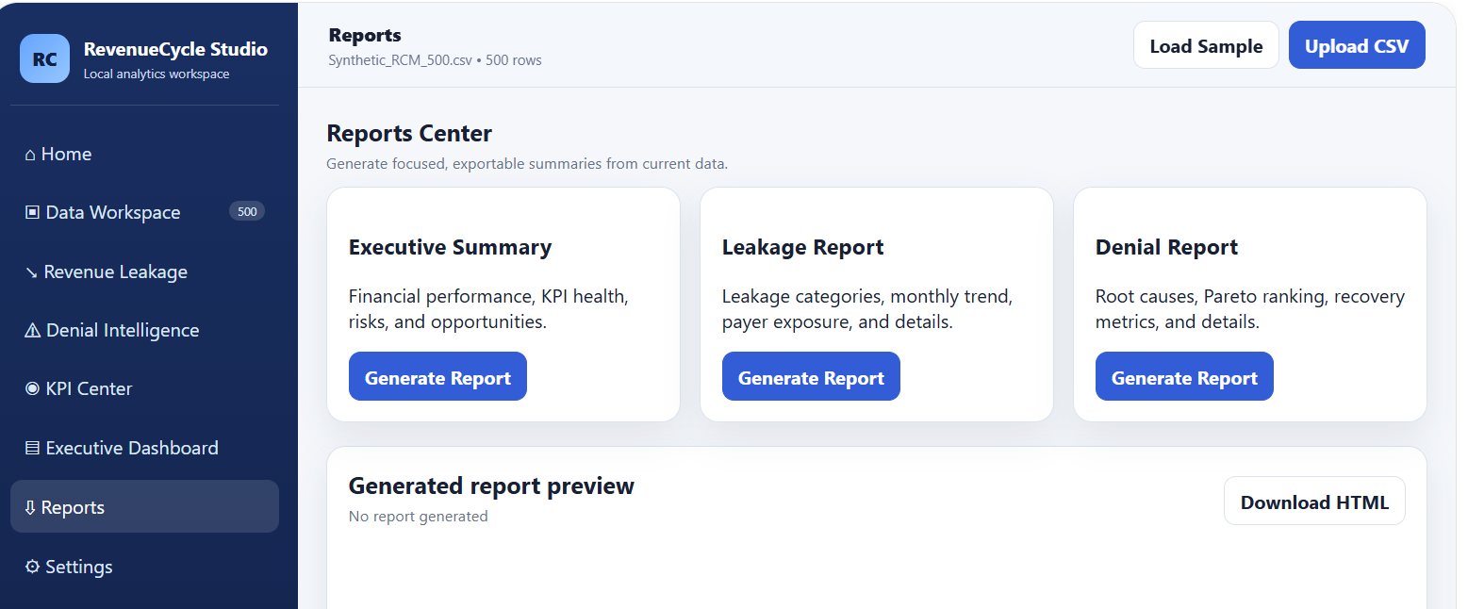
Report Center

Slide 15
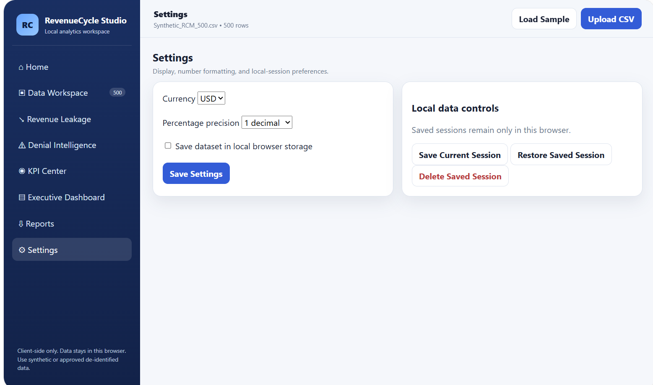
Settings

Slide 16
Acknowledgement
I am grateful to the OpenAI Team and collaborators for giving me this opportunity to participate in the Hackathon.
Thank You

